Slide 1
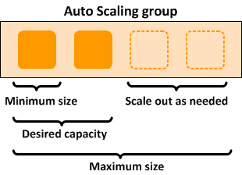
EC2 Auto Scaling
Amazon EC2 Auto Scaling helps you ensure that you have the correct number of Amazon EC2 instances available to handle the load for your application.
Maintain application availability by scaling up/down your Amazon EC2 automatically.
Adds more instance during high load.
Removes instances during less load.
It is a web service designed to launch or terminate EC2 instance automatically based on user-defind policies,schedules,and health checks.
It is manage Amazon EC2 Capacity automatically, maintain the Right no.of instance for your application, operate a healthy group of instance , and scale it accroding to your needs.
You create collections of EC2 instances, called Auto Scaling groups.

Slide 2
